Slide 1
Get That Money! Ensuring Ohio families know about and can access their tax credits During this webinar we will talk about: 1. The Impact of tax credits on children, adults, and families in Ohio 2. Overview of changes to the Child Tax Credit and eligibility 3. Overview of the Earned Income Tax Credit & the Child & Dependent Care Credit 4. How to access or help others access the credits that families are entitled to

Slide 2
We create a more vibrant, equitable, sustainable and inclusive Ohio through research, strategic communications, coalition building and policy advocacy. We create an economy that works…for everyone.
www.policymattersohio.org

Slide 3
Why cash matters for children and families
Living in deep poverty compromises children’s growth and development. When they grow up, they are more likely to have lower wages, more health issues, and are more likely to commit crimes.
When families have resources they need to pay for the basics, children are healthier, get better grades in school, have higher college enrollment rates, and earn more during their lifetime.
@PolicyMattersOH • policymattersohio.org

Slide 4
Why cash matters for children and families
The monthly child tax credit payments from July – Dec 2021 had an immediate impact on the economic security and stability of families
Decrease in hunger and food insecurity
Increase in the ability of families to pay for monthly basics (groceries, rent, healthcare, utilities, and child care)
reduced monthly child poverty by close to 30 percent
@PolicyMattersOH • policymattersohio.org
Notes:
The monthly tax credit payments ended in December. 3.7 million more kids are in poverty without the monthly Child Tax Credit, study says
The refundable earned income tax credit lifted 265,000 Ohioans out of poverty in 2016
Helps workers build financial security
Children have higher birth weights, get better grades in school, and earn more during their lifetime

Slide 5
Why cash matters for children and families
@PolicyMattersOH • policymattersohio.org

Slide 6
Children’s Defense Fund-Ohio The Children’s Defense Fund Leave No Child Behind® mission is to ensure every child a Healthy Start, a Head Start, a Fair Start, a Safe Start and a Moral Start in life and successful passage to adulthood with the help of caring families and communities. Children’s Defense Fund was founded in 1973 and is a private, nonprofit organization supported by individual donations, foundation, corporate and government grants. CDF provides a strong, effective and independent voice for all the children of America who cannot vote, lobby or speak for themselves. We pay particular attention to the needs of poor children, children of color and those with disabilities. CDF educates the nation about the needs of children and encourages preventive investments before they get sick, drop out of school, get into trouble or suffer family breakdown.

Slide 7
Child Tax Credit
What is it?
Federal legislation temporarily expanded and increased the CTC for the 2021 tax year: $3,000 per child for children under 17 $3,600 if under age 6 **Half of CTC was available in monthly payments of ($300 and $250 respectively) from July 15 - December 15, 2021. But those monthly advance payments only went to those who received it automatically b/c they had filed 2020 or 2019 taxes or to those who signed up through GetCTC.org. NOTE: All families must file their 2021 taxes this year to get the second half, or in some cases, the full amount of their Child Tax Credit!

Slide 8
Child Tax Credit
Who is eligible?
No income requirement! (This is a big and important temporary change to the Child Tax Credit!) Max credit phases out at: $75,000 - Single $112,500 - Head of Household $150,000 - Married Filing Jointly To claim the credit on behalf of a child, the child must: Have a Social Security Number Be under age 18 as of December 31, 2021 Live with you for more than half the year Have a particular relationship to you—child, adopted child, stepchild, grandchild, niece, nephew, or certain other relatives If a parent or caregiver is undocumented, they will need an ITIN number to file taxes and claim the benefit on behalf of their child(ren).

Slide 9
Babies Born in 2021
Most parents or guardians of new babies born in 2021 were not able to update their dependents in 2021, so they weren’t able to get the advanced child tax credits
This means they are eligible for the full $3600
SPREAD THE WORD!

Slide 10
Example
Family welcomes a new baby in Dec. 2021 and has a 4-year-old.
Family is entitled to the Child Tax Credit for her newborn, for a total of $3,600 of CTC payments.
They received the advanced monthly payments for her 4-year-old, but they will be entitled to the second half of $1,800 when they files taxes.
Total CTC payments for this family by filing taxes= $5,400

Slide 11
Third Stimulus Check (Recovery Rebate)
What is it? | Who is eligible?
Congress passed legislation to issue payments to people to reduce the financial burden of Covid-19 $1400 for each eligible adult and qualifying dependent **If you didn’t get your 3rd stimulus payment in 2021 or only got a partial payment, you can claim it as the Recovery Rebate Credit when you file a 2021 tax return | No income requirement, but does phase out at high incomes Any family member or dependent that has a SSN can receive the stimulus check The dependent you are claiming the stimulus payment for, cannot be a dependent of someone else. Must be a US citizen, permanent resident, or qualifying resident alien.

Slide 12
Revisiting our Prior Example
CHILD TAX CREDIT
Family welcomes a new baby in Dec. 2021 and has a 4-year-old.
Family is entitled to the Child Tax Credit for her newborn, for a total of $3,600 of CTC payments.
They received the advanced monthly payments for her 4-year-old, but they will be entitled to the second half of $1,800 when she files taxes.
Total CTC payments for this family by filing taxes= $5,400
RECOVERY REBATE
While, their 4-year old received their third stimulus payment, their newborn did not.
Recovery rebate for their newborn =$1400
From those two credits, the TOTAL amount this family is entitled to in CTC and Recovery Rebate Tax Credits = $6,800!!!
Let’s learn about other tax credits that you or families you serve might be entitled to by filing taxes!

Slide 13
Federal Earned Income Tax Credit
In 2021, the earned income tax credit is worth up to:
$6,728 for workers raising 3 or more children
$5,980 for workers raising 2 or more children
$3,618 for workers raising 1 or more children
$1,502 for workers without any dependent children
@PolicyMattersOH • policymattersohio.org
Notes:
A federal tax credit that can provide money or lower federal taxes. We also have a state EITC – I am focusing today on the federal EITC.

Slide 14
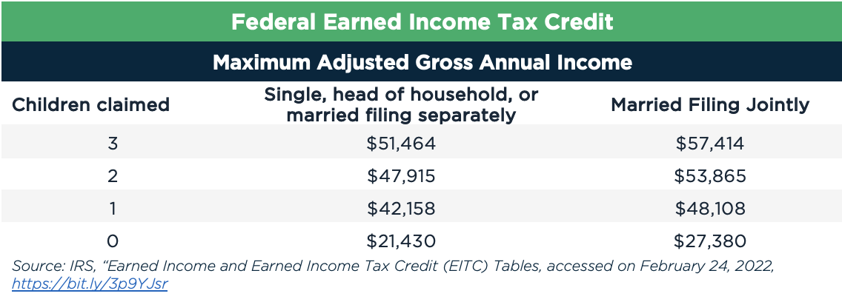
EITC eligibility - maximum income
@PolicyMattersOH • policymattersohio.org
Notes:
You must earn income

Slide 15
@PolicyMattersOH • policymattersohio.org

Slide 16
How would one family benefit?
Mary and John have two children (ages 4 and 7) and together make $40,000 annually.
Mary and John’s family would be eligible for $2,915 from the federal refundable EITC
@PolicyMattersOH • policymattersohio.org
Notes:
Stimulus payment – may have already received it – if not, they should get it in the next couple months. If they haven’t filled out their taxes, they should do so by May 17

Slide 17
The Child & Dependent Care Tax Credit (CDCTC)
In 2021, the credit is worth:
Up to $4,000 for one child under age 13
Up to $8,000 for two or more children under age 13
The amount depends on the number of dependents in care, your family income, and the amount you paid for care during 2021
@PolicyMattersOH • policymattersohio.org

Slide 18
How would one family benefit?
Mary and John have two children (ages 4 and 7) and together make $40,000 annually. They spent $4,000 for summer camp for their 7-year old and $5,000 for child care for the 4-year old in 2021.
Mary and John’s family would be eligible for $4,500 from the federal CDCTC -- 50% of $4,000 ($2,000) and 50% of $5,000 ($2,500)
@PolicyMattersOH • policymattersohio.org

Slide 19
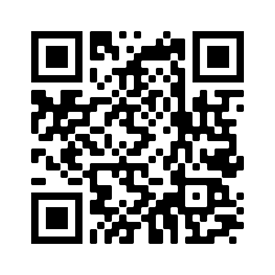
So… How can people get their Child Tax Credits and the other credits we just talked about!?
Let’s hear from Courtney from Code for America about how you can get your tax credits and how you can help others get theirs!
GetYourRefund.org/CTCOH

Slide 20
Notes:
Code for America is a nonprofit organization that partners with government to strengthen the delivery of public services through human-centered technology. In essence we are people-centered problem solvers. Showing that with the mindful use of technology Governmet can work well for everyone In

Slide 21
2022 GetYourRefund.org
Tax Filing Services
Notes:
Before I jump into what type of assistance is most valuable, I want to discuss what free filing services are available at GetYourRefund this year and how those services operate

Slide 22
 | GetYourRefund Full Service, Virtual VITA File for multiple years with assistance. | File Myself Facilitated Self Assistance/DIY File quickly online on your own for 2021 | GetCTC Express Simplified Filing File quickly on your own to collect your stimulus payments and Child Tax Credit. | VITA Site Location Finder In-person VITA Find a site near you for in-person help
Launch date and capacity | Launches 1/31/22 Limited capacity | Launches 1/31/22 Unlimited capacity | Launches May Unlimited capacity | Launch dates vary Capacity varies
Household income limit | under $66,000 | Under $73,000 | Under $25,000 ($12,500 if filing individually) | Typically under $58,000
Filing years | 2021-2018 | 2021 | 2021 | 2021-2018
Credits and payments | CTC, Stimulus, EITC, State Credits | CTC, Stimulus 3, EITC, State Credits | CTC, Stimulus 3 | CTC, Stimulus, EITC, State Credits
Required information | Photos of IDs (Social Security and ITIN paperwork) Photos of tax documents (w2s, 1099s, etc) | Social Security or ITIN numbers Tax documents (w2s, 1099s, etc) | Social Security or ITIN numbers | Paper copies of IDs (social security and ITIN paperwork) Tax documents (w2s, 1099s, etc)
Length of time to file IRS payment processing times vary 3-6 weeks | 2-3 weeks (includes 2 phone calls with VITA volunteer) | 45 minutes | 15 minutes | Depends on location
Other Considerations | IRS-certified VITA tax team ITIN application assistance Accessing required documents can be a major barrier for clients | IRS-certified chat support available Software is formatted for smartphones but computers or tablets are highly recommended | Waiting for simplified may not be a good option for households at risk of their dependent being claimed by someone else | IRS-certified VITA tax team ITIN application assistance (sometimes)
VITA-certified chat Support available!
Notes:
Transition

Slide 23
 | GetYourRefund Full Service, Virtual VITA File for multiple years with assistance.
Launch date and capacity | Launches 1/31/22 Limited capacity
Household income limit | under $66,000
Filing years | 2021-2018
Credits and payments | CTC, Stimulus, EITC, State Credits
Required information | Photos of IDs (Social Security and ITIN paperwork) Photos of tax documents (w2s, 1099s, etc)
Length of time to file IRS payment processing times vary 3-6 weeks | 2-3 weeks (includes 2 phone calls with VITA volunteer)
Other Considerations | IRS-certified VITA tax team ITIN application assistance Accessing required documents can be a major barrier for clients
GetYourRefund Process
Client completes GYR application and uploads pictures of ID and tax documents
Information is routed to VITA partner
Intake call
Return prepared by volunteer
Return reviewed by 2nd volunteer
Review call and e-sign return
Return is filed with IRS and state agency
*Additional scope limitations

Slide 24
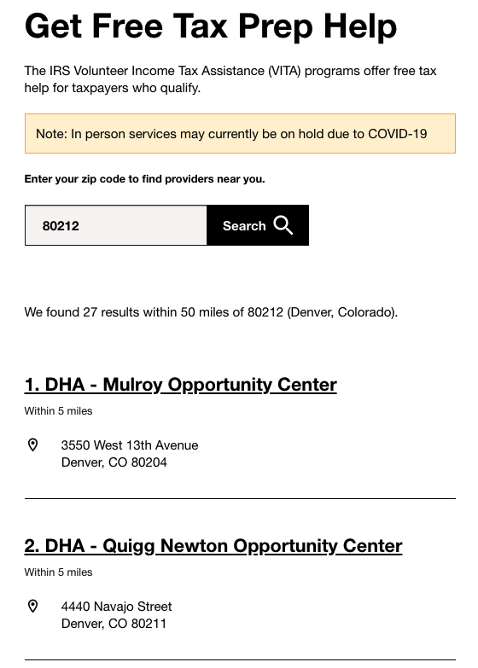
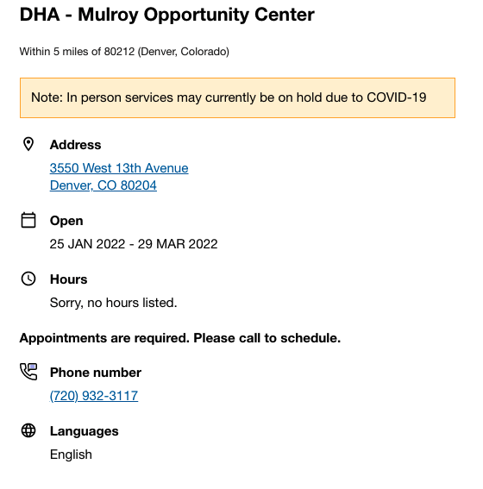
 | VITA Site Location Finder In-person VITA Find a site near you for in-person help
Launch date and capacity | Launch dates vary Capacity varies
Household income limit | Typically under $58,000
Filing years | 2021-2018
Credits and payments | CTC, Stimulus, EITC, State Credits
Required information | Paper copies of IDs (social security and ITIN paperwork) Tax documents (w2s, 1099s, etc)
Length of time to file IRS payment processing times vary 3-6 weeks | Depends on location
Other Considerations | IRS-certified VITA tax team ITIN application assistance (sometimes)
VITA Site Location Finder
Mobile-friendly
Uses information for the IRS VITA site locator
Important to click on the name to learn more details about the service

Slide 25
 | File Myself Facilitated Self Assistance/DIY File quickly online on your own for 2021
Launch date and capacity | Launches 1/31/22 Unlimited capacity
Household income limit | Under $73,000
Filing years | 2021
Credits and payments | CTC, Stimulus 3, EITC, State Credits
Required information | Social Security or ITIN numbers Tax documents (w2s, 1099s, etc)
Length of time to file IRS payment processing times vary 3-6 weeks | 45 minutes
Other Considerations | IRS-certified chat support available Software is formatted for smartphones but computers or tablets are highly recommended
VITA-certified chat Support available!
File Myself
Sends clients to free tax filing software (TaxSlayer)
Clients can return to GYR and use chat feature

Slide 26
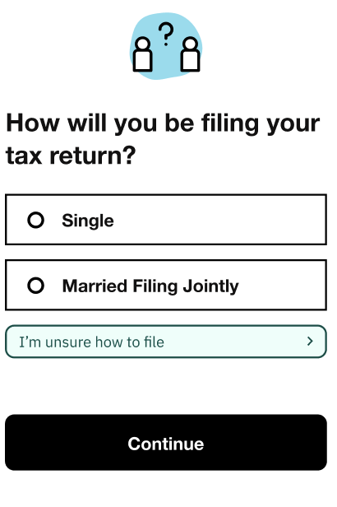
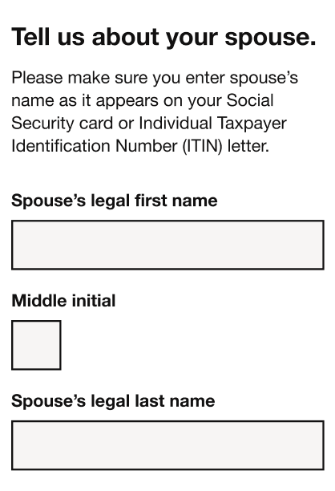
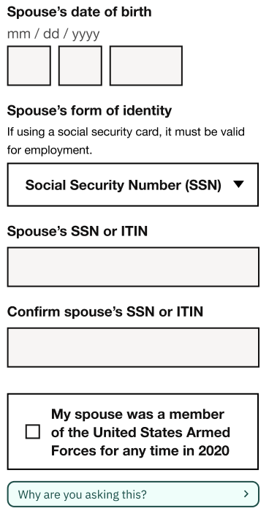
 | Express GetCTC, Simplified Filing File quickly on your own to collect your stimulus payments and Child Tax Credit.
Launch date and capacity | Launches April/May Unlimited capacity
Household income limit | Under $25,000 ($12,500 if filing individually)
Filing years | 2021
Credits and payments | CTC, Stimulus 3
Required information | Social Security or ITIN numbers
Length of time to file IRS payment processing times vary 3-6 weeks | 15 minutes
Other Considerations | Waiting for simplified may not be a good option for households at risk of their dependent being claimed by someone else
GetCTC Express
Clients can sign up for service notification now

Slide 27
Let’s take a quick look at GetYourRefund.org/CTCOH
Notes:
Navigate to website

Slide 28
Outreach to new or intermittent filers
Filing full tax return is the hope*
Full service filing: Outreach alone is not enough
Express filing: Outreach may be enough
Some filers may be disgruntled by the hurdles of filing a full tax return and give up.
It’s worth letting them know there will be another option
(aka non-filers)

Slide 29
How you can help clients access their benefits

Slide 30
Assistance to overcome challenges of
Awareness and Trust Building
Acquiring Documents and Information
Setting up GYR Virtual VITA support site
Access to and assistance with tech
Guides coming soon
Setting up a File Myself Support Site
Reassurance
Access to and assistance with tech
Guides coming soon
Notes:
Awareness and Trust Building
Why should they file
How can they file for free
Understanding their options
Acquiring Documents and Information
What documents do they actually need
Request replacement social security cards
How to access tax documents
Adv CTC payments and EIP3
2020 Adjusted Gross Income
Setting up a GetYourRefund Virtual VITA support site
ACCESS TO AND ASSISTANCE WITH TECH
Build trust in service
Access to technology (tablets or smartphones) and reliable wifi
Navigating screens
Help upload pictures of documents
Well lit, clearn, entire document
Explain next steps or give take home document
Setting up a File Myself support site
Building confidence: Let’s give this a try!
Access to technology (computers or tablets) and reliable wifi
Consider time and space needed
Connect them with support
File Myself guide
GYR chat support
Reassurance and tech support
Take your time, click next, etc.
Do not give tax advice -> use chat
Provide other options

Slide 31
Getting Started
None of the assistance mentioned requires certification or training
Decide which types of assistance you want to offer - you can add more as needed!
Identify partners who are well equipped to meet needs and are trusted in their communities
Sign up for GYR Navigator Updates here or at GetCTC.org/navigators
Use GetYourRefund.org/CTCOH
Know what you can and can’t do:
Can: Provide access online tools and build trust/reassurance in process
Cannot: Provide tax advice (without additional training and certification)
Familiarize yourself with available resources
GYR Navigator Resources/Modules
GetYourRefund Chat
Local VITA programs, LITCs, existing outreach programs
Dive in!

Slide 32
Coming Soon: 2022 Navigator Resources
GetCTC.org/navigators
Available now
Chat assistance available to users and navigators
Service Options
Outreach materials
Research-based reports
Coming soon
Setting up File Myself Stations
Setting up GetYourRefund Stations
Post Filing Assistance

Slide 33
Thank you!
Email us at Navigators@getyourrefund.org
Visit us at getctc.org/navigators

Slide 34
Help spread the word!
April 18 is the deadline to file taxes
Share the http://www.getyourrefund.org/CTCOH link with people you serve
Use a social media toolkit to help spread the word: https://thesocialpresskit.com/ctcoutreach#outreach-materials-for-2022--flyers-multiple-languages
Word of mouth makes a real difference - https://www.policymattersohio.org/blog/2022/03/14/get-that-money-now-expanded-tax-credits-can-help-families-meet-their-basic-needs-and-thrive
@PolicyMattersOH • policymattersohio.org

